Slide 1

Social Media Survey
Probability and Statistics by Mirsaid 12225253

Slide 2

Survey Questions
Main Question:
Other questions:
What is your favourite social media platform?
Telegram
Instagram
You Tube
Tik-Tok
Twitter
How many hours do you use this social media platform daily?
________________________
If you post regularly on social media, how many followers do you have on chosen platform?
_________________________

Slide 3

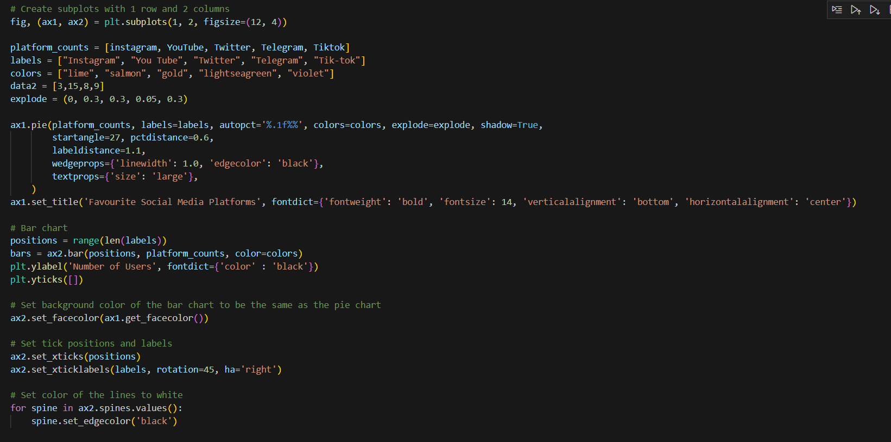
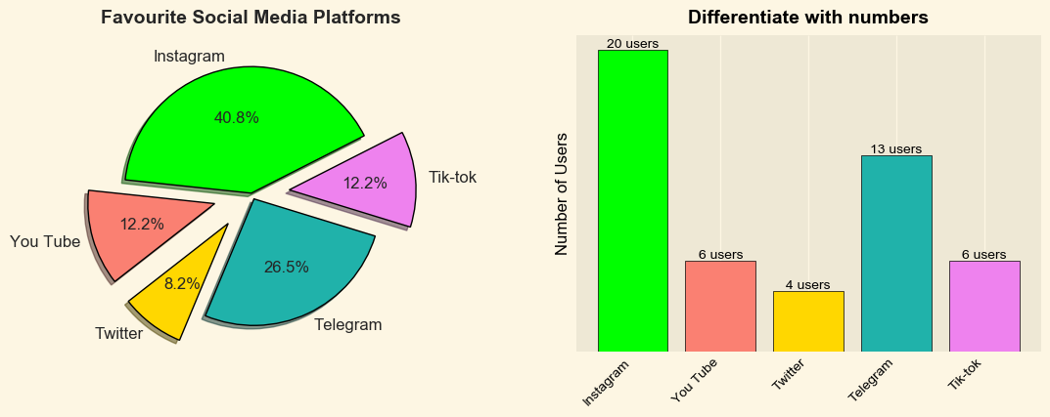
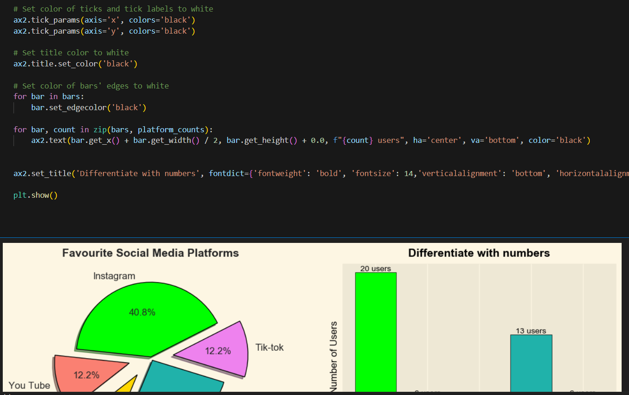
Favourite social media platform:
Sample size: 49 users
Pie chart is made in Python Library using matplotlib

Slide 4
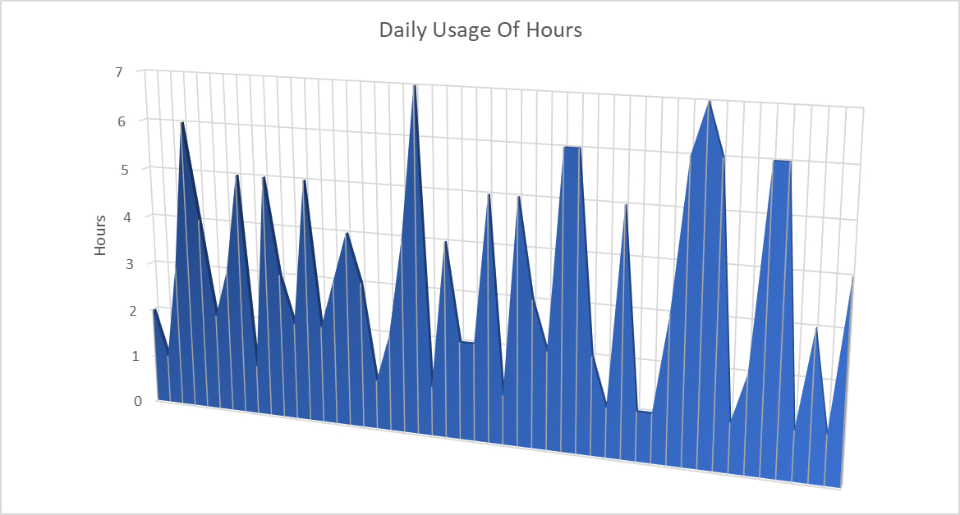
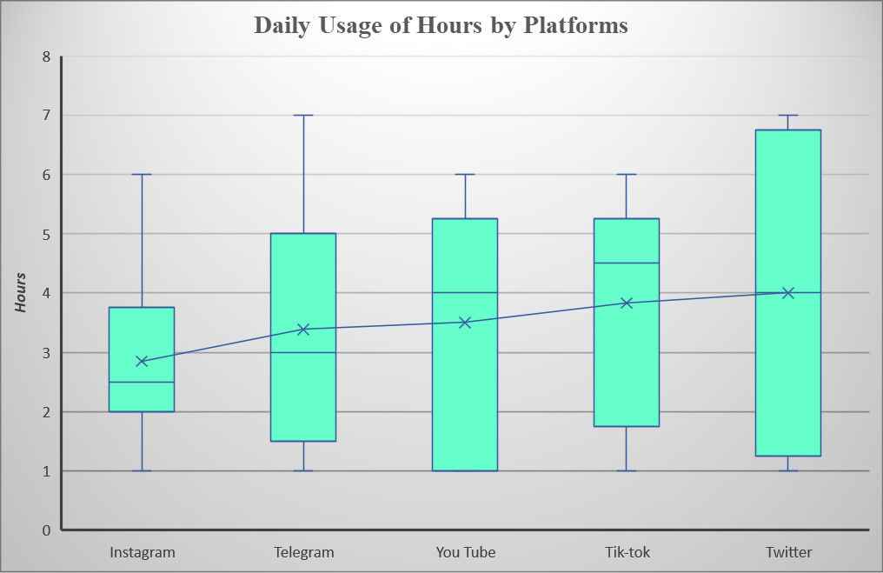
Daily Hour usage descriptive Statistical analysis: Note: Chart made in excel
Data Analysis and Correlation with boxplots:
Mean | 3.2857143
Standard Error | 0.2719919
Median | 3
Mode | 1
Standard Deviation | 1.9039433
Sample Variance | 3.625
Kurtosis | -1.1464877
Skewness | 0.3830333
Range | 6
Minimum | 1
Maximum | 7
Sum | 161
Sample size | 49

Slide 5
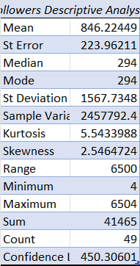
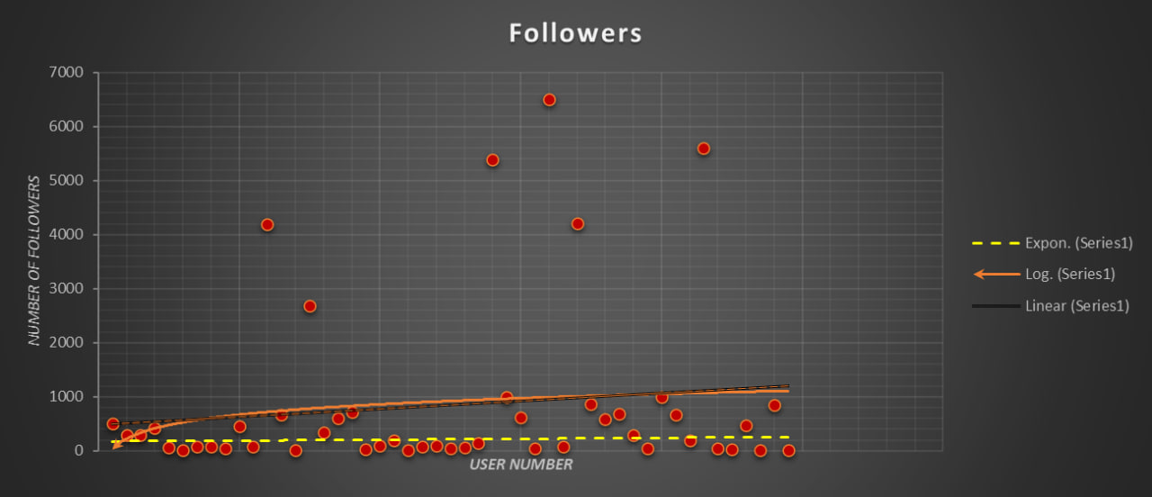
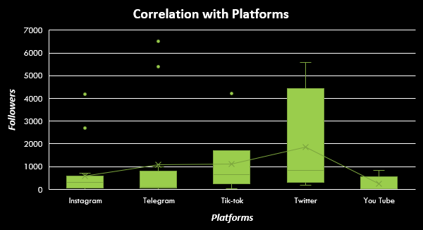
Followers: Descriptive Statistics:
Data Analysis by Scatterplots:
Correlation:

Slide 6
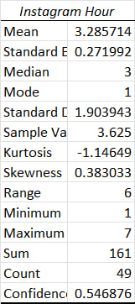
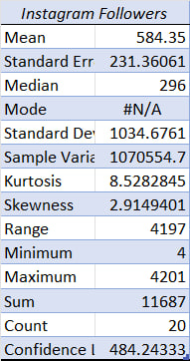
Analyze the data by platform Instagram:

Slide 7
Telegram:
Correlation coefficient 0.694289
Telegram Followers Descriptive Statistics
Mean | 1096.0769
Standard Error | 605.58746
Median | 94
Mode | #N/A
Standard Deviation | 2183.4766
Sample Variance | 4767570.2
Kurtosis | 3.3858928
Skewness | 2.1559111
Range | 6497
Minimum | 7
Maximum | 6504
Sum | 14249
Count | 13
Confidence Level(95.0%) | 1319.4617
Telegram Hours Descriptive Statistics
Mean | 3.3846154
Standard Error | 0.5493406
Median | 3
Mode | 1
Standard Deviation | 1.9806759
Sample Variance | 3.9230769
Kurtosis | -0.9176471
Skewness | 0.3541347
Range | 6
Minimum | 1
Maximum | 7
Sum | 44
Count | 13
Confidence Level(95.0%) | 1.1969105
ANOVA
Source of Variation | SS | df | MS | F | P-value | F crit
Between Groups | 7760847.1 | 1 | 7760847.1 | 3.2556797 | 0.0837419 | 4.2596773
Within Groups | 57210890 | 24 | 2383787.1
Total | 64971737 | 25

Slide 8
You tube:
You Tube Followers Descriptive Statistics
Mean | 1000
Standard Error | 775.46947
Median | 40
Mode | #N/A
Standard Deviation | 2051.6994
Sample Variance | 4209470.3
Kurtosis | 6.4591086
Skewness | 2.5197222
Range | 5585
Minimum | 12
Maximum | 5597
Sum | 7000
Count | 7
Confidence Level(95.0%) | 1897.5054
You Tube Followers Descriptive Statistics
Mean | 4
Standard Error | 0.8997354
Median | 5
Mode | 1
Standard Deviation | 2.3804761
Sample Variance | 5.6666667
Kurtosis | -1.5923875
Skewness | -0.3113564
Range | 6
Minimum | 1
Maximum | 7
Sum | 28
Count | 7
Confidence Level(95.0%) | 2.2015732

Slide 9
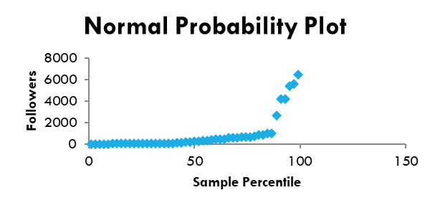
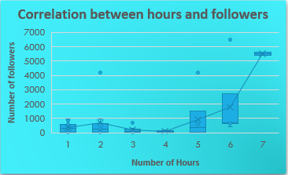
Other important information:
ANOVA:Single Factor
SUMMARY
Groups | Count | Sum | Average | Variance
Followers | 49 | 41465 | 846.22449 | 2457792.4
Hours | 49 | 161 | 3.2857143 | 3.625
ANOVA
Source of Variation | SS | df | MS | F | P-value | F crit
Between Groups | 17408372 | 1 | 17408372 | 14.165839 | 0.0002882 | 3.9401627
Within Groups | 117974209 | 96 | 1228898
Total | 135382580 | 97
Regression Statistics | Value
Multiple R | 0.6198261
R Square | 0.3841844
Adjusted R Square | 0.363351
Standard Error | 1401.3269
Observations | 49
Correlation coefficient 0.468185

Slide 10
Summary:
Unknown phrases:
1. Kurtosis: Kurtosis is a measure of the tails of a probability distribution. In descriptive statistics, it provides information about the shape of a distribution's tails in comparison to a normal distribution.
2. Skewness: Skewness is another measure in descriptive statistics that provides information about the asymmetry of a probability distribution. It helps us understand the degree and direction of skew (departure from horizontal symmetry) in a dataset.
Survey link: Here
If you have any questions feel free to ask!
Thank you for your attention

